Slide 1

Are there any trends in Fuel prices in Perth?
Hint:
What are the trends
How do you know
How could we prove it
Powerwrite
You have 2 mins

Slide 2

POPCORN
Pop your ideas
Pop up and share your ideas ONE AT A TIME PLEASE

Slide 3
Fuel prices in c/L
Week | Mon | Tues | Wed | Thurs | Fri | Sat | Sun
1 | 112 | 130 | 127 | 123 | 118 | 116 | 112
2 | 108 | 129 | 126 | 123 | 119 | 115 | 113
3 | 109 | 131 | 128 | 124 | 120 | 116 | 114
Draw the time series graph for this table
(plot the points and connect the dots)
Price
time
Notes:
hook

Slide 4
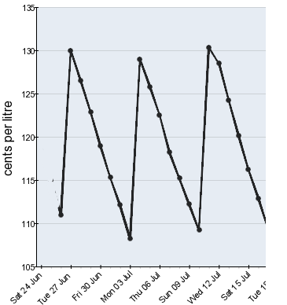
It should look something like this

Slide 5
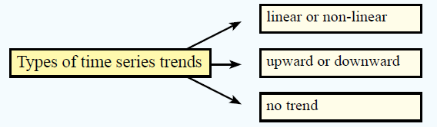
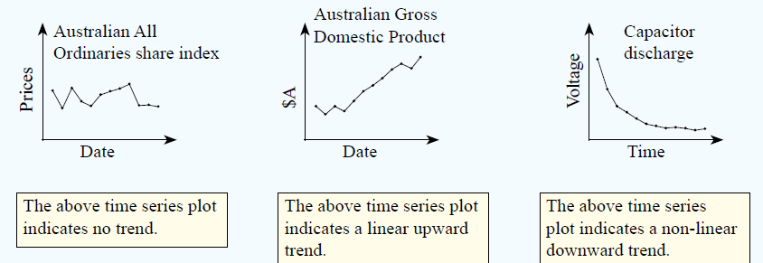
24
7
30
Date
Time series data
EQ – How can we use time series data?
A time series is a series of data points listed or graphed in time order. Most commonly, a time series is a sequence taken at successive equally spaced points in time.
Describe the Data
5
Notes:
Lesson objective (EQ)

Slide 6
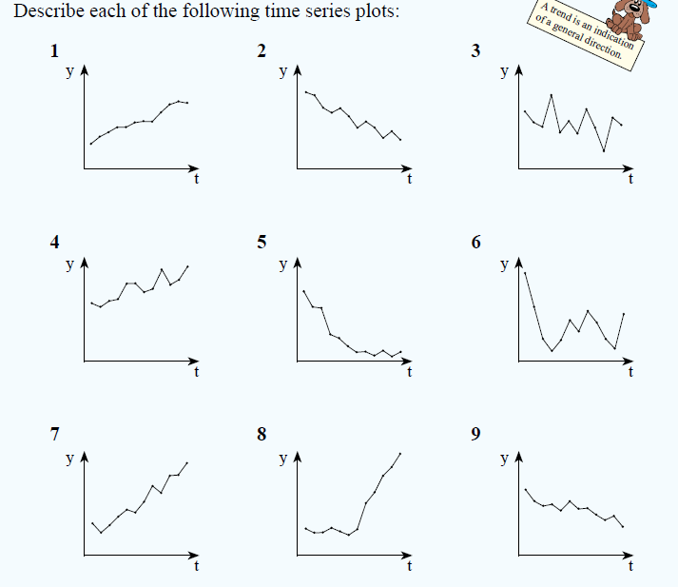
Describe the following time series data
Notes:
Check for understanding

Slide 7
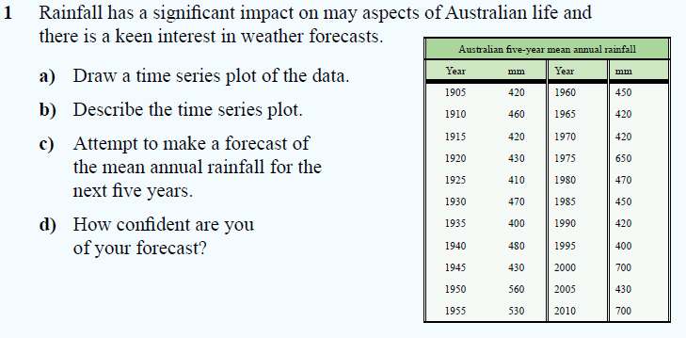
If you can’t see the numbers Pg 251 in the text book
Notes:
Independent practice

Slide 8
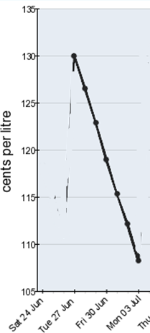
Can we manipulate the fuel data to change the relationship?
Let’s say we only use the data from Tuesday to Monday of one week
Notes:
Closure
Discussion with the class

